Slide 1
Collective Intelligence Presentation Example
Szilard Kovacs
kovacsszilard@inf.elte.hu

Slide 2
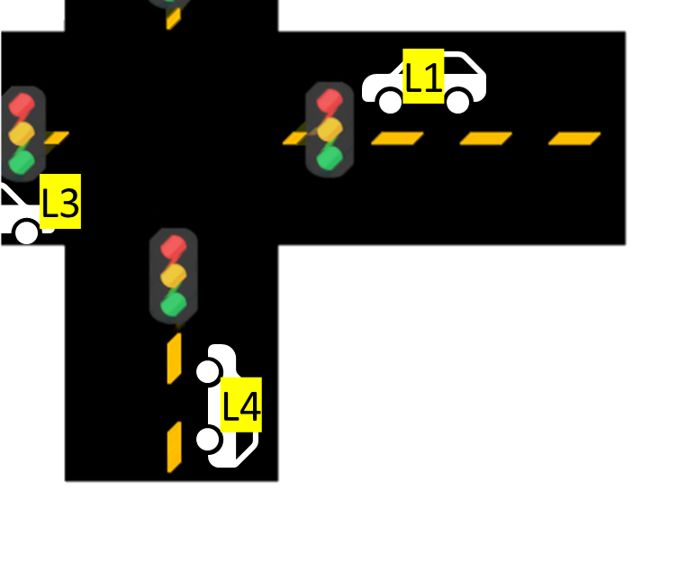
Example Project
Task
Goal
Image(s)

Slide 3
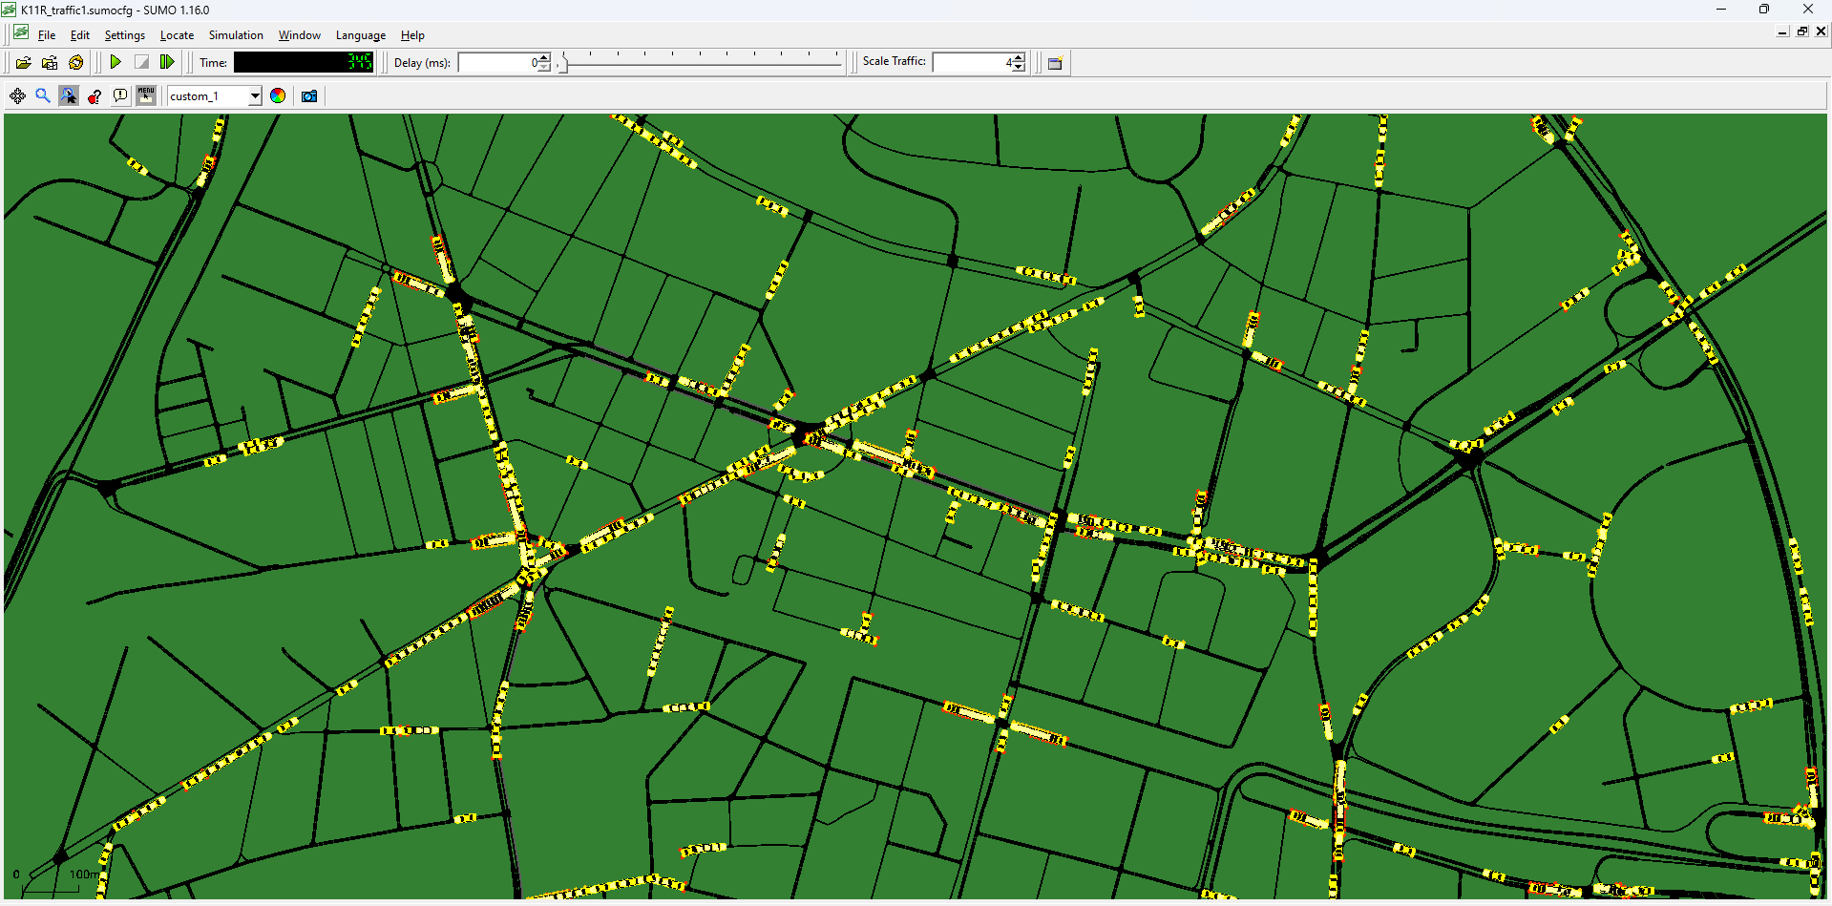
Environment
2D Environment
With 720x720 pixel
Each individual block is 20x20
…
Image(s)

Slide 4
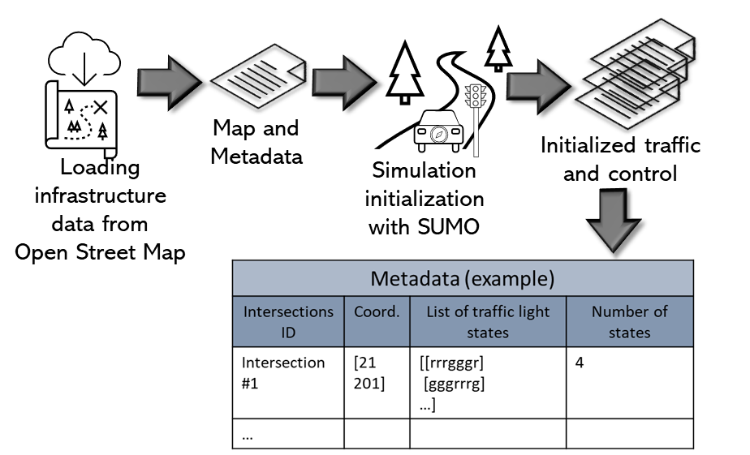
Observation spaces
Whole environment (Test 1, 2,..)
K-nearest neighbor (Test 3,..)
Combined
…
Image(s)

Slide 5
Action spaces
Up
Down
…
Pick up
Put down
Complex action
…
Image(s)

Slide 6
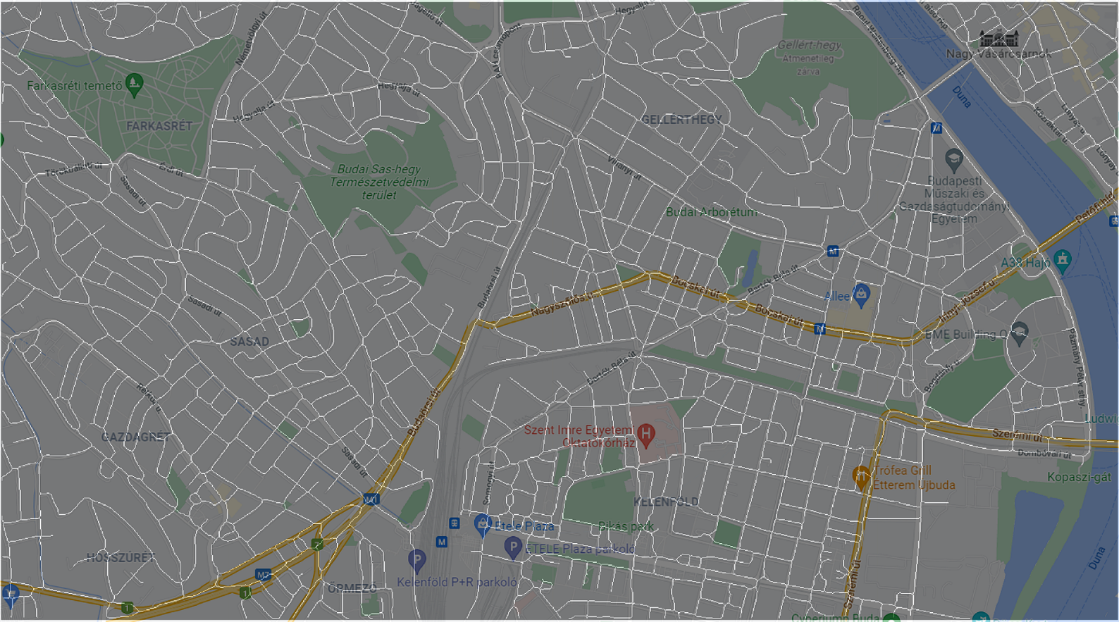
Models and Policies
Models
Random action
Simple conditional decision
MLP
LSTM
…
Policies
Fix
PPO
A2C
Q-learning
…
Policy optimization
Reward
Model
Action
Observation
Image(s)
Backpropagation
Environment
Real world

Slide 7

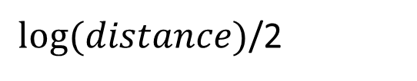
Rewards
Positive
Distance
Uniform filling
Shape outline
Cluster distribution
…
Negative
Iteration number
…
$log⁡(distance)$/2
Image(s)

Slide 8
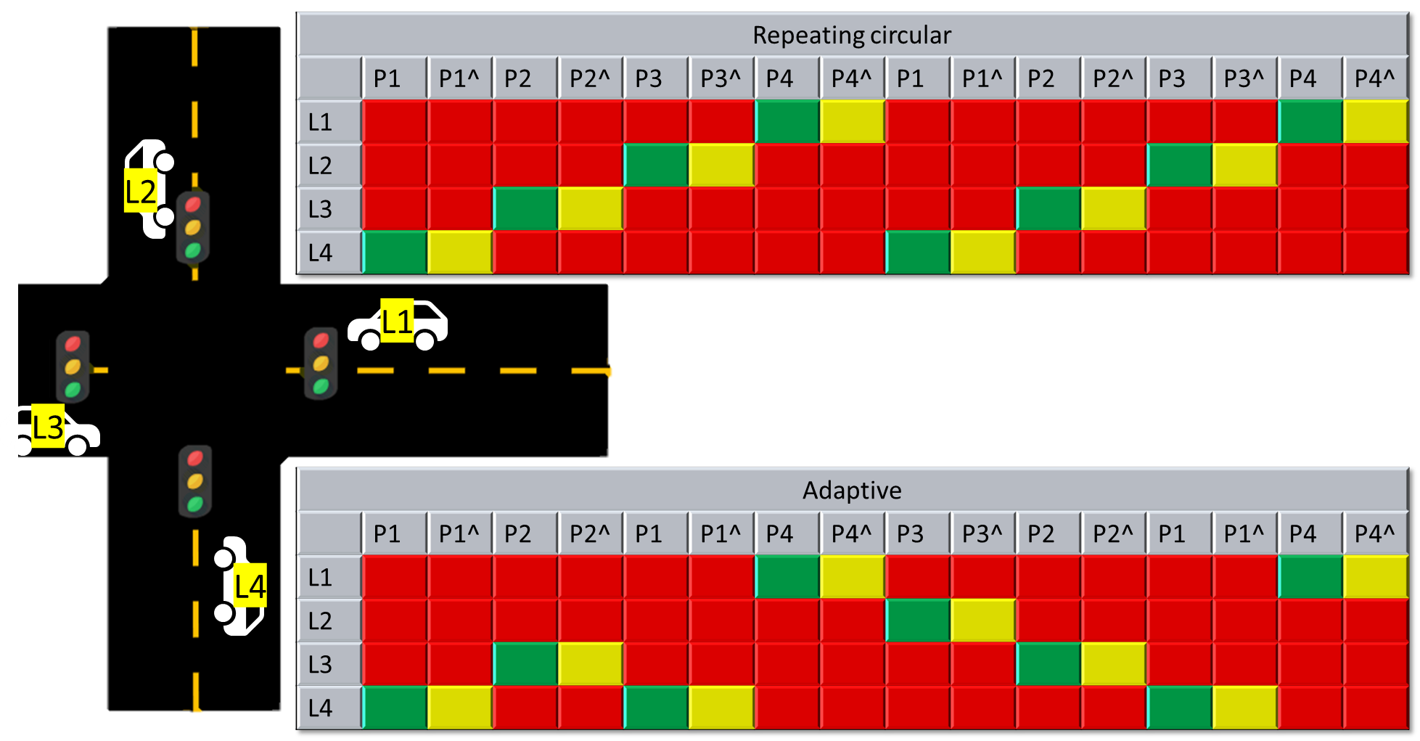
Evaluation metrics
Travel time
Emission
Number of turns
Number of iterations
Number of collisions
Distances
…
Image(s)

Slide 9
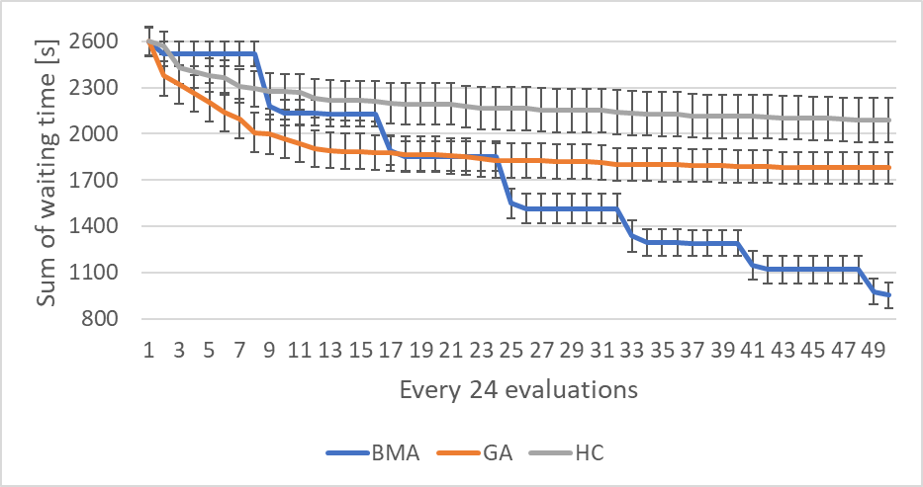
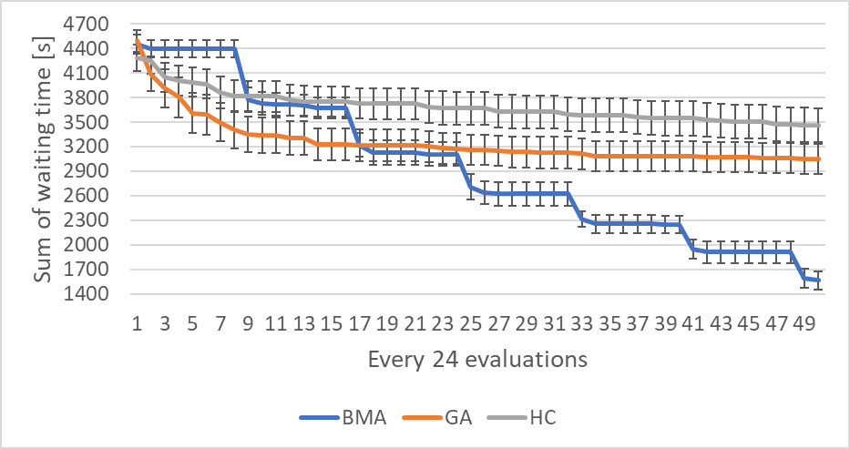
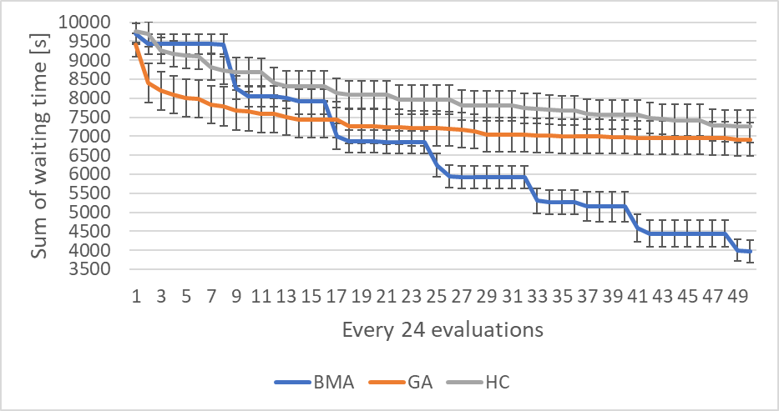
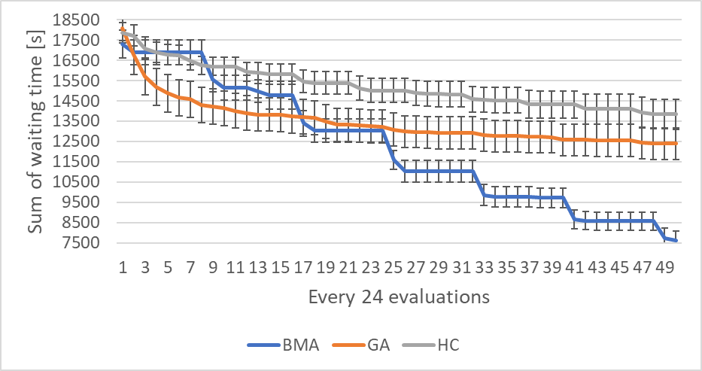
Results Test/Comparison 1 Example
Test/comparison description
Image(s)

Slide 10
Results Test/Comparison 2 Example
Test/comparison description
Image(s)

Slide 11
Conclusion and Further Work Example
Conclusion
Scalable RL algorithm
Parallel execution for real-time
35…45% performance boost in Scenario 1
-1…5% performance boost in Scenario 2
Further Work
Hyperparameter search
Hybrid RL model

Slide 12
Thank You for Your attention!
Name
{email}@inf.elte.hu
Questions?

